Slide 1






Smart Contracts and Solidity Basics
Language Overview, Writing Solidity Code
Svetlin Nakov
Senior Technical Trainer
Academy School of Blockchain
http://kingsland.academy

Slide 2



Table of Contents
What is Solidity?
Ethereum Virtual Machine (EVM)
Solidity Dev Environment & IDEs
Compile, Publish, and Test Contracts
Smart Contract Basics
Solidity programming: contracts, functions, data types, arrays, maps, structs, modifiers, inheritance, …

Slide 3

Ethereum Virtual Machine and Solidity
Architectural Concepts

Slide 4

What is Solidity?
Solidity is a contract-oriented, high-level programming language
Syntax similar to JavaScript and C#
Runs in the Ethereum Virtual Machine (EVM)
Statically typed language (like C# and Java)
Complex user-defined types (structs)
Contracts and inheritance (like in OOP)
Libraries (like in any other dev platform)
Official documentation: https://solidity.readthedocs.io

Slide 5
Solidity Code Compilation
Bytecode (EVM instructions)
Solidity Code
Solc compiler
ABI definition
Ethereum Virtual Machine (EVM) is the environment where the contracts are executed
Code execution costs money (called gas)
Application Binary Interface (ABI) – describes the contract’s interface
Public methods + input arguments + return values + contract events

Slide 6
Solidity Code Compilation (2)
deploy
Bytecode (EVM instructions)
Ethereum Blockchain
invoke
ABI definition
Accessing the contract
To publish the contract, the bytecode is uploaded to the blockchain
To access it, you need the ABI definition to know what inputs and outputs the contract operates with

Slide 7
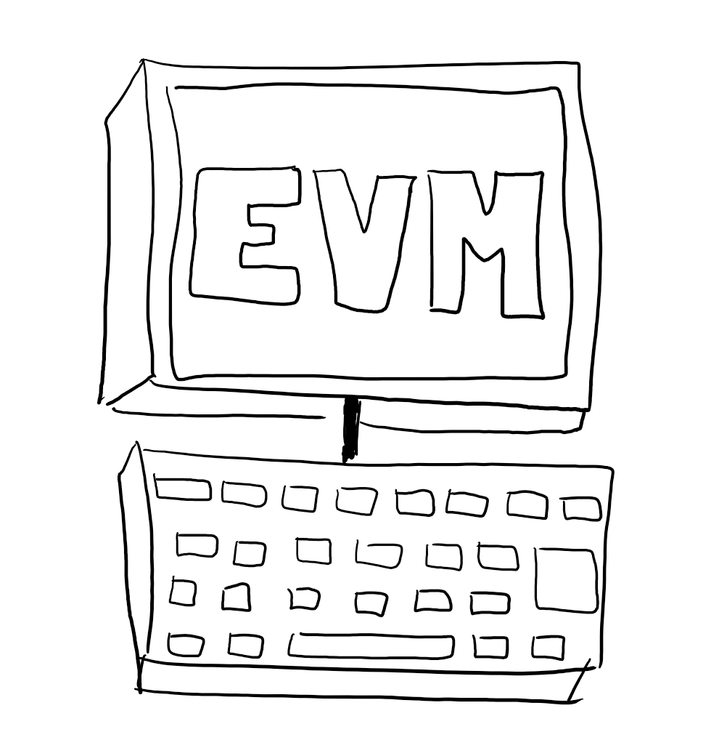
What is Ethereum VM?
Simple but powerful Turing-complete 256-bit Virtual Machine
Accessible from any Ethereum Node in the network
Crucial role in the consensus engine of the Ethereum system
Guarantees and fully determines an outcome of an executed code

Slide 8
Transaction Validation in EVM
EVM uses validators to ensure transactions are OK
Validators take a transaction and apply it executing the associated code, make sure that:
The transaction is valid (e.g. encoding, sender signature, constraints, etc.)
The sender has enough funds to pay for the execution
The EVM did not throw any exceptions during the execution

Slide 9
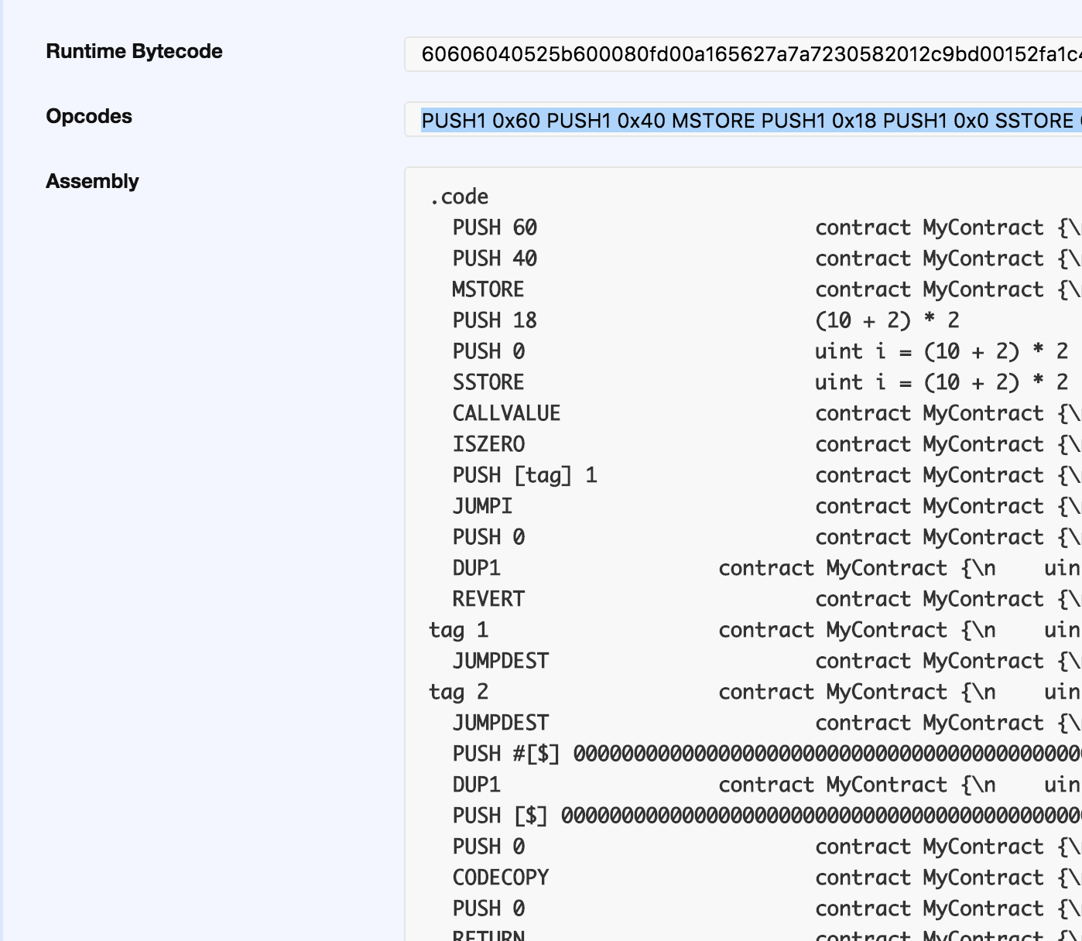
EVM
EVM is stack-based VM
Uses bytecode to encode the instructions
Developers use Solidity
Compiled to bytecode
EVM assembly code can also be used
For advanced developers

Slide 10
Ethereum Gas Measurement
Contracts aren’t free, execution costs gas
Gas is the internal unit for keeping track of execution cost
Gas measures the consumed computational resources
Each CPU instruction in EVM costs gas: 1 gas = 1 computational step
Each persistent storage write also costs gas
E.g. writing 32 bytes in the contract memory costs 80 000 gas
Gas price can be negotiated (cannot be 0 to avoid spam):
1 gas ~= 20 Gwei (dynamic)

Slide 11
Gas Payments
Gas is measured and paid for at each contract execution
Every transaction to a contract or contract creation
Reading data from a contract (reading its state) is free!
Code execution / data storage is paid
The gas price is set by the caller (you)
The lower the price, the more time it will take for a miner to include the tx in a block
Best gas price calculator: https://ethgasstation.info

Slide 12
Gas Limit
Gas limit == maximum allowed gas usage in a transaction
Sum of all gas spending for all operations and storage
Do not reach the limit!
Current contract execution will be terminated
Any changes to the contract’s state will be reverted

Slide 13
Operations and Gas
Operations that cost gas:
Anything that changes the blockchain state:
Writing to contract’s memory
Execution of contract logic
Uploading data to blockchain (contract publishing)
Free operations:
Anything not requiring changes, like:
Reading blockchain data (contracts, their state, …)
Examples: get contract metadata, check account balance, etc.

Slide 14
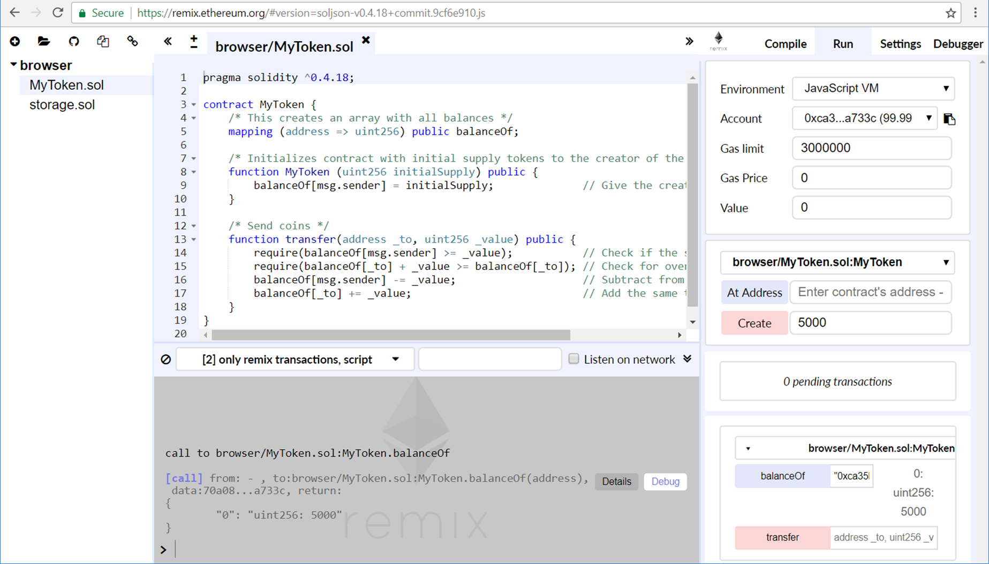
Solidity in Practice
Write and Run Solidity Code in Remix IDE

Slide 15

Installing Solidity Dev Environment
Remix
In-browser Solidity IDE
https://remix.ethereum.org
Solidity compiler
https://www.npmjs.com/package/solc
Ethereum testrpc + Truffle Framework
https://github.com/ethereumjs/testrpc
http://truffleframework.com

Slide 16
Playing with Ethereum Remix

Slide 17

Contracts Programming Basics
Contracts in Solidity are
Like classes and interfaces in the OOP languages
Contracts may hold
Data + functions
Just like classes in OOP
Contract execution is paid with gas consumption
contract SomeContract {
uint someData;
function someFunc(uint p) {
// function body …
}
…
}

Slide 18
Example: Simple Storage Contract
pragma solidity ^0.4.18;
contract SimpleStorage {
uint private storedData;
function set(uint x) public {
storedData = x;
}
function get() view public returns (uint) {
return storedData;
}
}
Persistent data stored in the blockchain
Public member function: anyone can invoke it
Public function: does not change the contract's state

Slide 19
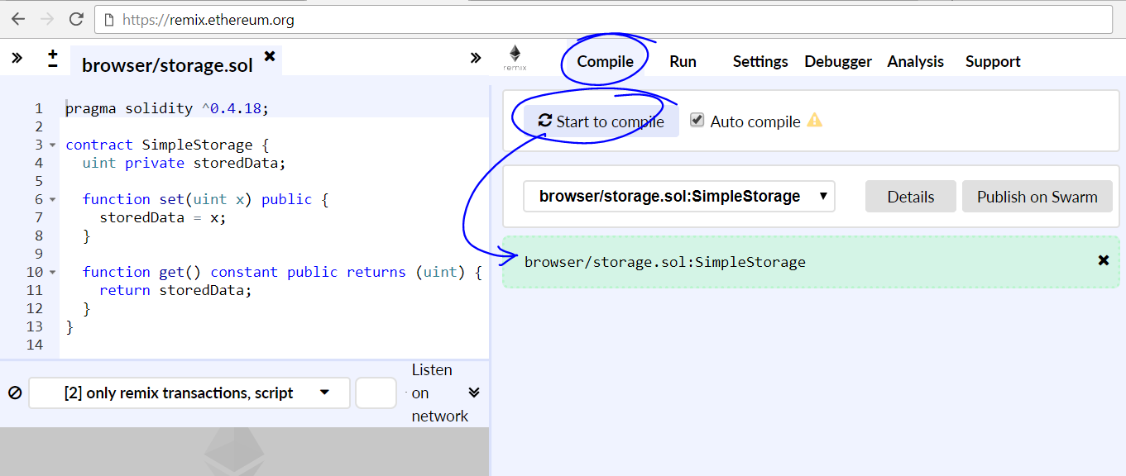
Compiling the Contract in Remix

Slide 20
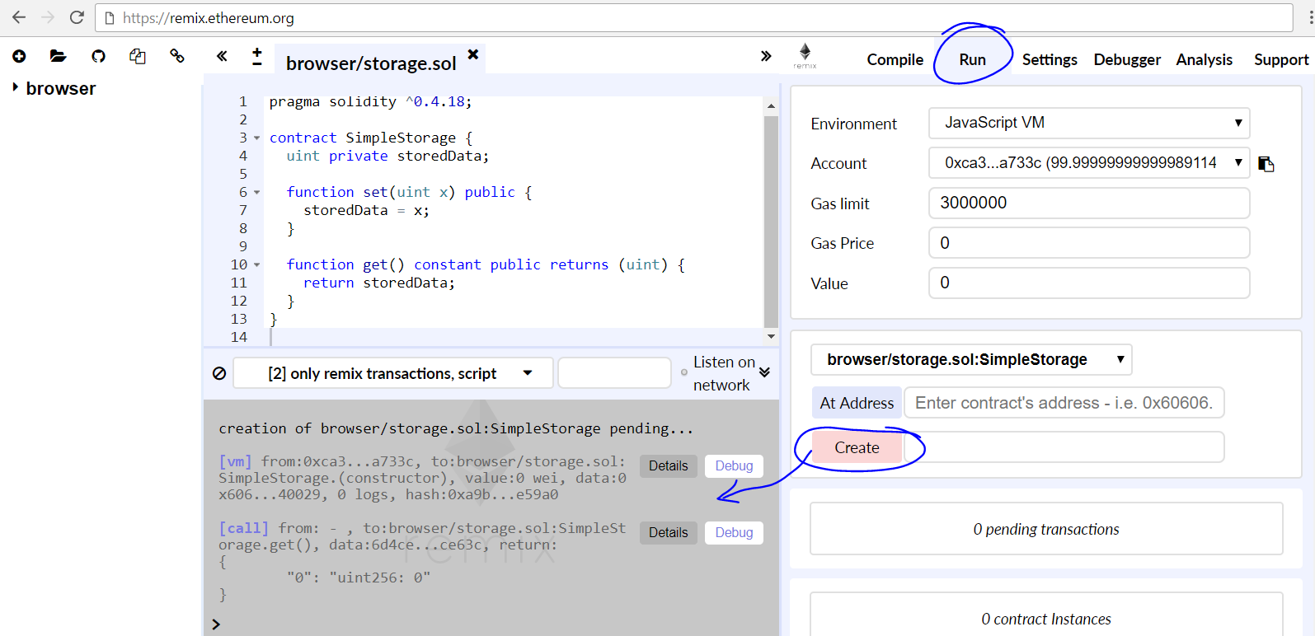
Deploying the Contract in a Testing EVM

Slide 21
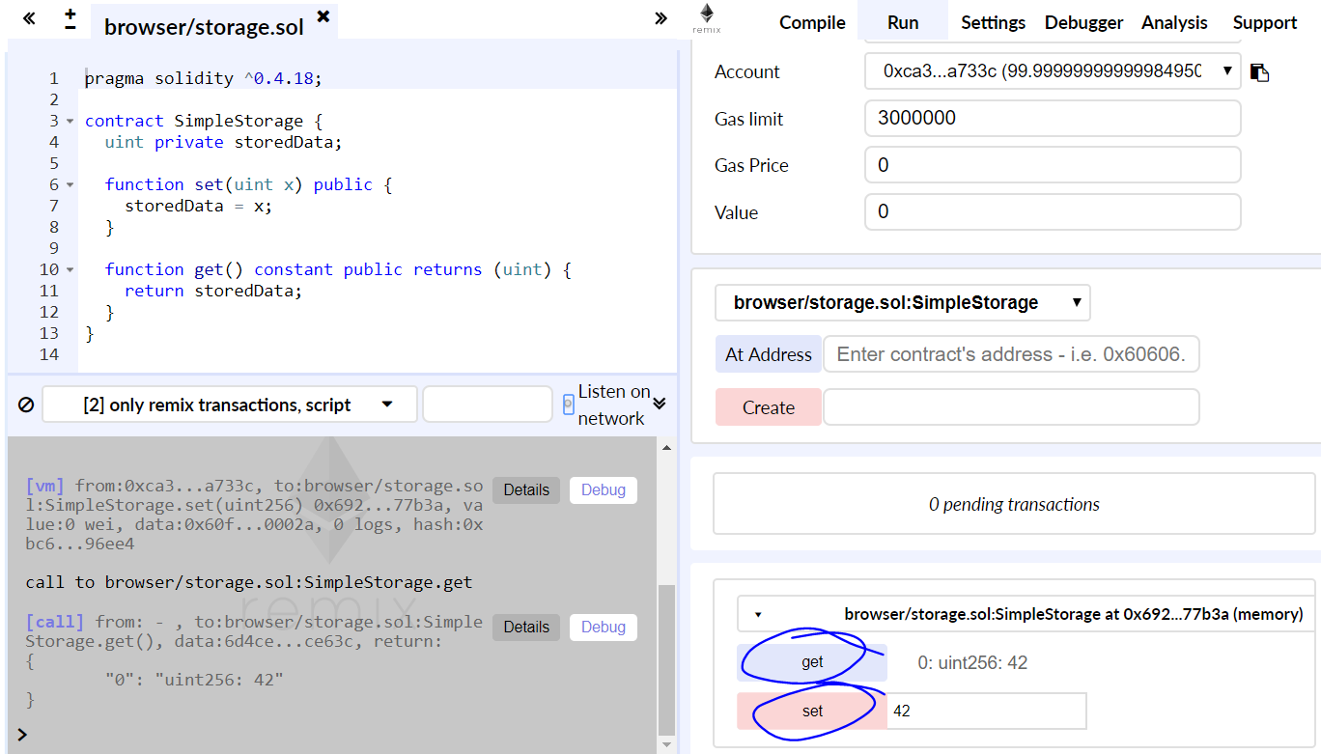
Invoking Functions on the Deployed Contract

Slide 22
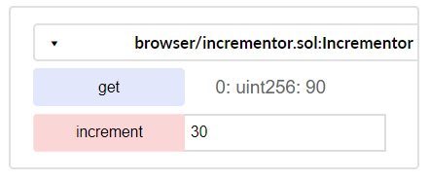
Problem: Incrementor Contract
Write a Solidity contract
Contract holds a certain value
value (uint)
Anyone can read the value
get() → uint
Anyone can increment the value
increment(uint delta)
increment
value

Slide 23
Solution: Incrementor Contract
pragma solidity ^0.4.18;
contract Incrementor {
uint private value;
function increment(uint delta) public {
value += delta;
}
function get() view public returns (uint) {
return value;
}
}
Persistent data stored in the blockchain
Change the persistent data field
Read the persistent data field

Slide 24
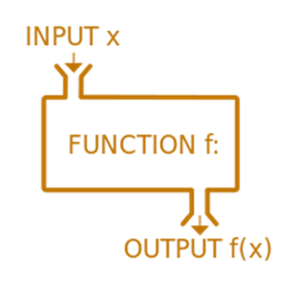
Functions in Solidity
Functions with no output
Functions returning values
function increment(uint delta) public {
value += delta;
}
Function visibility: external / public / internal / private
function get() view public returns (uint) {
return value;
}
Promise not to modify the state of blockchain
Specify explicitly the return type

Slide 25
Data Types in Solidity
Data types are similar to most programming languages:
int8 / uint8, … uint256 (uint) – integers of 8 … 256 bits
No floating-points numbers (still)
bool – true / false value
string – UTF8-encoded text, e.g. "Hello, Solidity!" or ""
address – Ethereum address (EIP 55 encoded)
e.g. 0xdCad3a6d3569DF655070DEd06cb7A1b2Ccd1D3AF
enum – enumerated type
enum YesNo {Yes, No}
YesNo answer = YesNo.Yes;

Slide 26
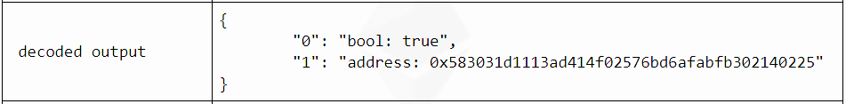
Problem: Last Invoker
Write a Solidity contract
Keep the address of its previous invoker
getLastInvoker() → returns (bool, address)
true / false – if a previous invoker exists or not
The address that has invoked the contract before you

Slide 27
Solution: Last Invoker
pragma solidity ^0.4.18;
contract LastInvoker {
address private lastInvoker;
function getLastInvoker() public
returns (bool, address) {
address result = lastInvoker;
lastInvoker = msg.sender;
return (result != 0x0, result);
}
}
Keep the last invoking address in the contract's persistent storage
The address of the contract's invoker is sent as msg.sender

Slide 28
Arrays
// Array of fixed size
uint8[3] nums = [10, 20, 30];
nums[0] = 32;
0 1 2
10 | 20 | 30
// Dynamic array (variable size)
uint24[] score;
function addScore(uint24 s) public returns (uint) {
if (score[score.length-1] < s)
score.push(s);
return score.length;
}
0 1 2 …
50 | 62 | 73 | …

Slide 29

Problem: Array of Facts
Create a Solidity contract
Contract owner (creator) can
Add facts (string values)
Anyone can read the facts
count() – returns the count of facts
getFact(index) – returns specified fact by index [0…count-1]
Solidity cannot return all facts (array of strings)
Nobody can delete facts or destroy the contract

Slide 30
Solution: Array of Facts
Hold all the facts in array stored on the blockchain
contract Facts {
string[] private facts;
address private contractOwner = msg.sender;
function add(string newFact) public {
require (msg.sender == contractOwner);
facts.push(newFact);
}
function count() view public returns (uint) {
return facts.length;
}
function getFact(uint index) view public returns (string) {
return facts[index];
}
}
Check for ownership
Append an element into the array
Solidity functions cannot return string[] so we use a workaround

Slide 31
Structs
A simple structure holding two data fields
struct Account {
address addr;
uint amount;
}
Account acc = Account({
addr: 0xdCad3a6d3569DF655070DEd06cb7A1b2Ccd1D3AF,
amount: 50});
Account peterAcc = Account(
0xca35b7d915458ef540ade6068dfe2f44e8fa733c, 180);
acc.amount += 20;
Creating an object of given structure
Creating another object
Accessing a field from the structure

Slide 32
Maps
mapping (string => address) private accounts;
accounts["Peter"] =
0xdCad3a6d3569DF655070DEd06cb7A1b2Ccd1D3AF;
struct Account {
string personName;
uint amount;
}
mapping (address => Account) accByAddr;
accByAddr[0xdCad3a6d3569DF655070DEd06cb7A1b2Ccd1D3AF] =
Account("Peter", 120);
Mappings can be used as fields in the contracts only. No instantiation is needed.

Slide 33


Problem: Registry of Certificates
A company issues certificates for completed trainings
Each certificate has its data and content calculated as hash
The registry of all valid certificate hashes stored on the blockchain
Owner can add certificate hashes: add(hash)
Anyone can verify а certificate by its hash: verify(hash)
hashing
add(…)
Hashes stored in the blockchain
0x6a7e9e1…
verify(…)
true / false

Slide 34
Solution: Registry of Certificates
contract Certificates {
mapping (string => bool) private certificateHashes;
address contractOwner = msg.sender;
function add(string hash) public {
require (msg.sender == contractOwner);
certificateHashes[hash] = true;
}
function verify(string hash) view public
returns (bool) {
return certificateHashes[hash];
}
}
Contract owner only
Store the certificate hash on the blockchain

Slide 35
Data Locations
Objects in the storage location are persisted in the blockchain
Objects in the memory location are temporary
contract PersistentStorage {
uint[] data; // Persistent data kept in the "storage" location
}
Data location "storage" assumed implicitly
function calcSize(uint8 t) public pure returns (uint8) {
// Explicitly specified data location "memory"
uint8[3] memory sizes = [10, 20, 30];
return size[t];
}

Slide 36
Function Modifiers
contract ChangeableOwner {
address public owner = msg.sender;
modifier onlyBy(address account) {
require(msg.sender == account);
_; // Don't forget to invoke the original function's body!
}
function changeOwner(address newOwner) public onlyBy(owner) {
owner = newOwner;
}
}
Define a modifier attacheable to any other function
Modifiers inject functionality before & after a function call

Slide 37
Inheritance
Base contract (parent class)
pragma solidity ^0.4.18;
contract Owned {
function Owned() public { owner = msg.sender; }
address internal owner;
}
contract Terminatable is Owned {
function terminate() public {
require (msg.sender == owner);
selfdestruct(owner);
}
}
Derived contract (child class)
owner is derived
Destroys the contract, its stored data and removes it from the blockchain

Slide 38

Problem: Create a Simple Token
Create a simple token contract
The initial supply is specified at contract's creation
The entire initial supply is held by the contract's creator
Token owners can send tokens to other addresses
transfer
0x2C…e9
transfer
owner
0x6a51…7F
create
transfer
transfer
0x7…5b
contract (initial supply)
0x38ad…e3

Slide 39
Solution: Simple Token
contract SimpleToken {
mapping (address => uint256) public balanceOf;
function SimpleToken (uint256 initialSupply) public {
balanceOf[msg.sender] = initialSupply;
}
function transfer(address to, uint256 value) public {
require(balanceOf[msg.sender] >= value); // Check the sender balance
require(balanceOf[to] + value >= balanceOf[to]); // Overflow check
balanceOf[msg.sender] -= value; // Subtract the value from the sender
balanceOf[to] += value; // Add the same value to the recipient
}
}

Slide 40

Summary
Solidity is a high-level programming language
Designed to write smart contracts in the Ethereum VM
Remix is a powerful online Solidity IDE
Solidity programming: contracts, functions, data types, arrays, maps, structs, modifiers, inheritance, …
contract SomeContract {
uint someData;
function someFunc(uint p) {
…
}
}

Slide 41

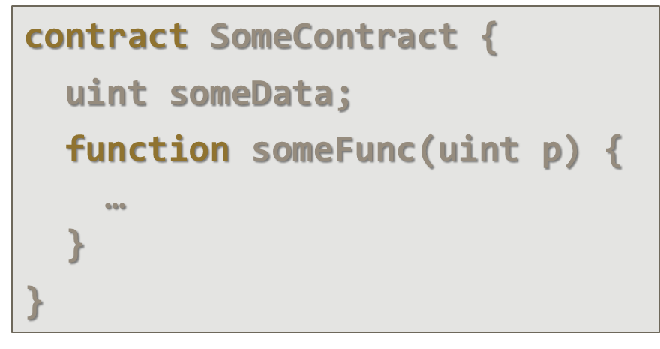


Smart Contracts and Solidity Basics
http://kingsland.academy

Slide 42
Resources
Remix – https://remix.ethereum.org
Solidity official documentation – https://solidity.readthedocs.io/en/develop/
Solidity tutorials – https://ethereumbuilders. gitbooks.io/guide/content/en/solidity_tutorials.html
Learn Solidity in Y Minutes – https://learnxinyminutes.com/docs/solidity/
Solidity Code Style Guide – http://solidity.readthedocs.io/en/ develop/style-guide.html

Slide 43
Resources (2)
https://ethereum.stackexchange.com
https://github.com/OpenZeppelin/zeppelin-solidity/commit/370e6a882aef6b9600949594d3a3e4854260d51e
https://medium.com/@jeff.ethereum/optimising-the-ethereum-virtual-machine-58457e61ca15
http://www.blockchainexpert.uk/blog/what-is-solidity
https://github.com/OpenZeppelin/zeppelin-solidity

